Slide 1

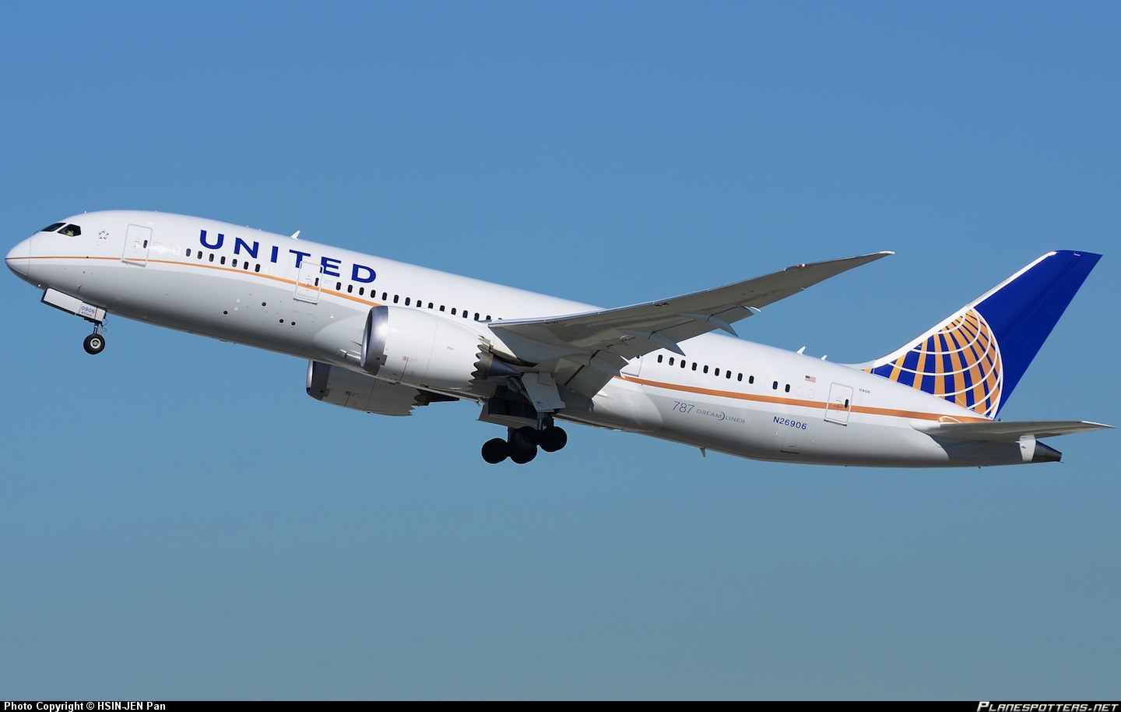

Quintiq Overview for United Airlines
June 30, 2015
Donna Davis
Account Executive
Pete Nelson
Solutions Architect
Dr. Edwin Lohmann
Business Unit Director
Notes:
Owner: TC Baker, BUNA, February 2013

Slide 2
Agenda
Introductions
Overview and Understanding of United Airlines Puzzle
Quintiq Overview
Demonstration
Demonstration
Quintiq Architecture
Quintiq Customers
Quintiq EngaQugement Process
Quintiq Engagement Process
Quintiq EngaQugement Process
Q&A, Next Steps

Slide 3
Agenda
Introductions
Overview and Understanding of United Airlines Puzzle
Quintiq Overview
Demonstration
Demonstration
Quintiq Architecture
Quintiq Customers
Quintiq EngaQugement Process
Quintiq Engagement Process
Quintiq EngaQugement Process
Q&A, Next Steps

Slide 4
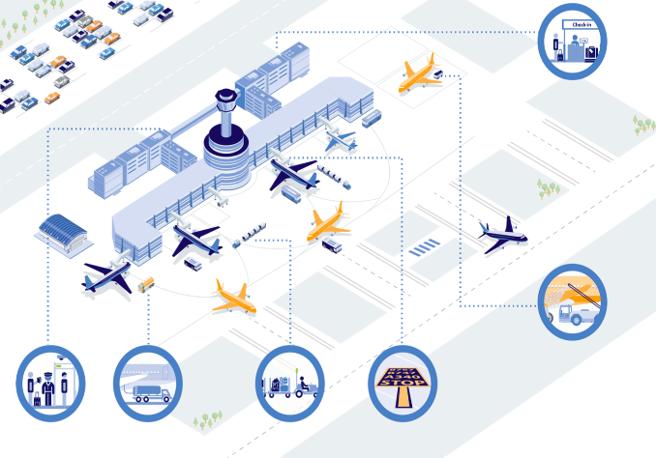


United Airlines Puzzle
One Connected Planning Platform
Long-term
Medium-term
Short-term
Day of Ops
Single Source of Truth
System Planning of Record
Customer Service
Gate Agents
Baggage Handlers
Ramp
What-if Analysis
Notes:
Multiple sources:
Sea
Land
Shale gas
Associated gas
- Initial part of the supply chain picture refers to the Qatar case where gas is fields are in the sea.
This is not always the case (for e.g. Algerian gas is in the Sahara).
- General comment: Gas is also produced on oil wells (this is called associated gas e.g. Oman) and then goes through the similar gas
processing as non-associated gas. So, the available natural gas that is sent to the liquefaction plan may come from several sources.
The same is true for shale gas. The US is also building new liquefaction plants to export their shale gas.
- LNG transfer from ship to regas terminal is via pipeline (not truck)
- From the regas terminal several options possible:
--> regasify and send into gas distribution network (for industrial and residential use incl. CNG as fuel)
--> load LNG on road tankers (trucks) for further distribution (small scale LNG business)
--> Re-load LNG on other vessels for further distribution

Slide 5
Agenda
Introductions
Overview and Understanding of United Airlines Puzzle
Quintiq Overview
Demonstration
Demonstration
Quintiq Architecture
Quintiq Customers
Quintiq EngaQugement Process
Quintiq Engagement Process
Quintiq EngaQugement Process
Q&A, Next Steps

Slide 6

Quintiq founding vision
Develop a single application capable of solving any type of planning puzzle

Slide 7


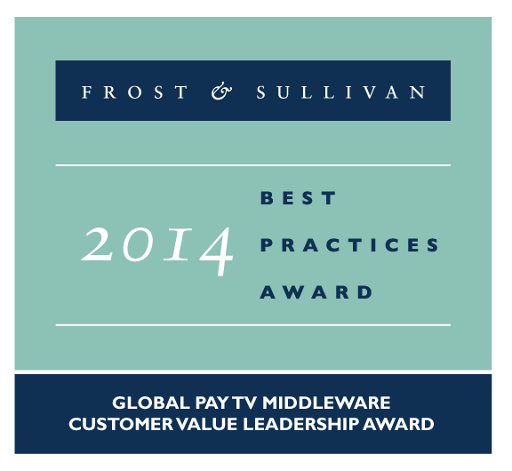











Profile
Focus
Quintiq is a leading software solution focused on delivering supply chain planning and optimization (SCP&O).
Facts
Quintiq was founded in 1997
The company’s SCP&O revenue has been growing at 37% CAGR since 2009
It has 800+ dedicated employees and is in use by companies in over 80 countries worldwide
It is #4 in global market share and the fastest-growing SCP&O company among top-tier vendors
In 2014, Quintiq was acquired by Dassault Systèmes (3DS), one of the world’s largest software companies
Partners
Quintiq has a powerful international implementation partner network.
Recognized leadership

Slide 8
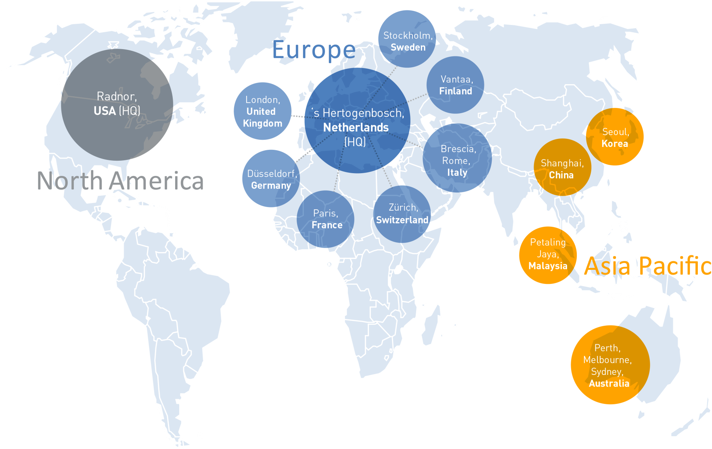
Quintiq offices around the world
15
Offices
Used in
82
countries
worldwide
Business conducted in
10
languages

Slide 9
Key challenges facing airlines today
Varied roles, skills, and qualifications
On-time departures & arrivals
Changing demands
Causal events impacting operations
Unplanned absences
Work Rules
Visibility
Changing Technology
Notes:
Note:
- Eric Pearson’s modifications to the IS Vision presentation

Slide 10

And many considerations when planning…
Real-time analytics
Forecasting
Adherence
Operational planning and scheduling
Volatility
Assignments &
Task Management
What-if Analysis
Flexibility
Mobile Workforce
Your world is a puzzle
Notes:
Ripple effect on airport operations
Create a nice title
Add fueling and skip maintenance

Slide 11
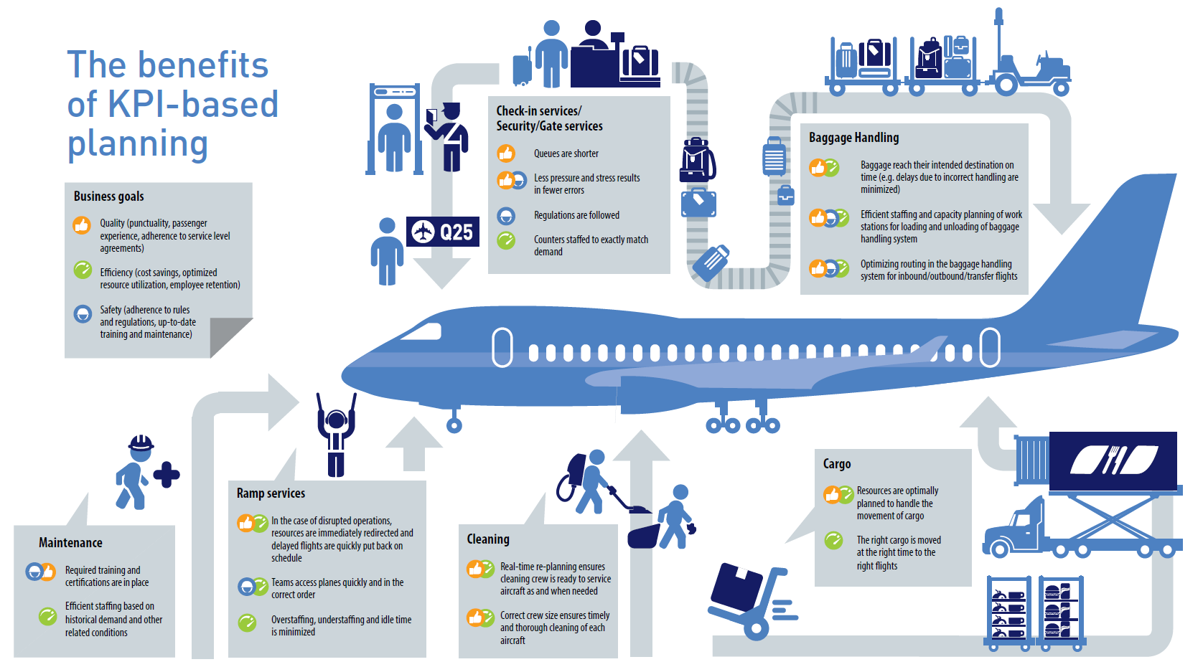
Quintiq: a single platform to conquer your challenges

Slide 12

Airline Planning Process flows
Commercial
Aircraft
Base maintenance
Crew
Ground
Strategic
Network
planning
Fleet planning
Flight
hours
Transition planning
Capacity planning
Strategic
Available fleet
Maintenance requirements
Route plan
Routes
Aircraft planning
Gross
FTE
Crew
shortages
Available resources
Resource shortages
Flight
hours
Base maintenance planning
Tactical
Airline scheduling
Tactical
Crew planning
Resource planning
Equipment
type
Aircraft scheduling
Flights
Flights
Flights
Aircraft maintenance
Maintenance slots
Available
crew
Crew
efficiency
Resources plan
Resource
efficiency
Operational
Anonymous
rotations
Operational
Crew pairings & rostering
Base maintenance scheduling
Resource scheduling
Flights
Flights
Flights
Tail assignment
Planned
schedule
Planned
movements
Planned
tasks
Planned
rosters
Planned ground tasks
Execution
Execution
Schedule & pax control
Aircraft dispatch
Maintenance control
Crew control
Ground operations control
Operational changes
Notes:
Rationalised the verticals, Commercial = Schedule + Other.
Combined some solutions over multiple verticals or planning horizons (e.g. Scheduling, fleet planning, integrated dops).

Slide 13
Agenda
Introductions
Overview and Understanding of United Airlines Puzzle
Quintiq Overview
Demonstration
Demonstration
Quintiq Architecture
Quintiq Customers
Quintiq EngaQugement Process
Quintiq Engagement Process
Quintiq EngaQugement Process
Q&A, Next Steps

Slide 14
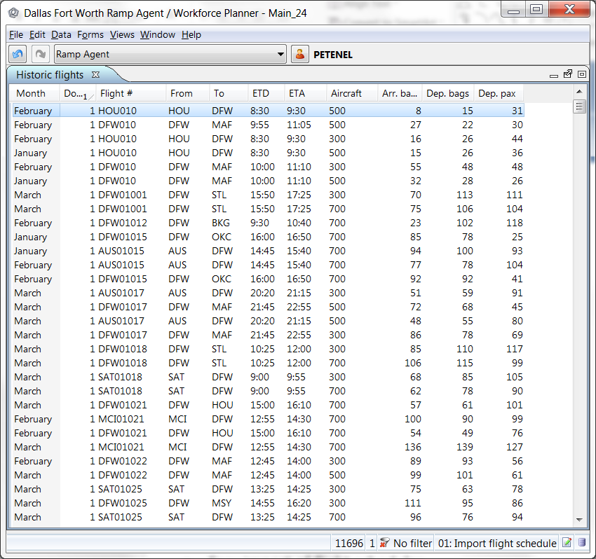
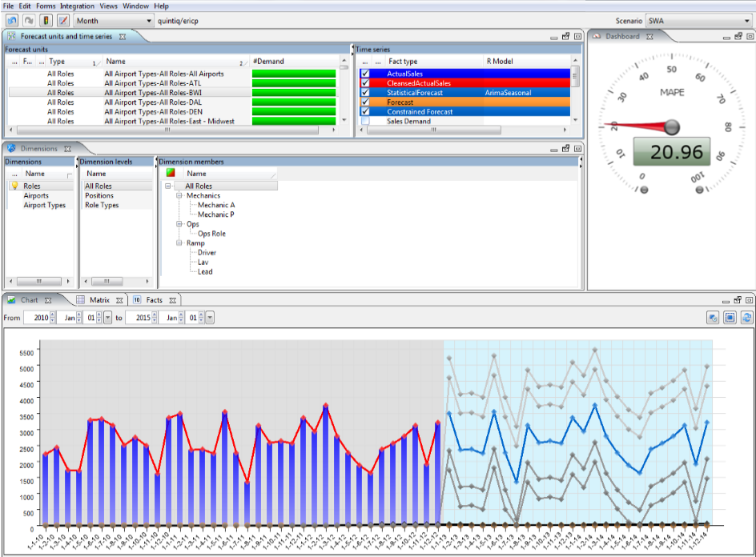

Planning
Long-term
Medium-term
Short-term
Predict Flight Reqmts
Import Flight Schedules
Task Creation/ Management
Task Requirements at Stations
Optimize demands, create shifts
Annual Leave Planning
Generate bid lines
Assign bid lines
Day of Ops, task assignment
Predict Flight Requirements
Expected passenger load
Expected bags
View by flexible flight attributes
Key Benefits
Simple analysis, enhance with sophisticated techniques
Predictability using analysis of past passenger and baggage loads
Visibility of changes and their impact

Slide 15
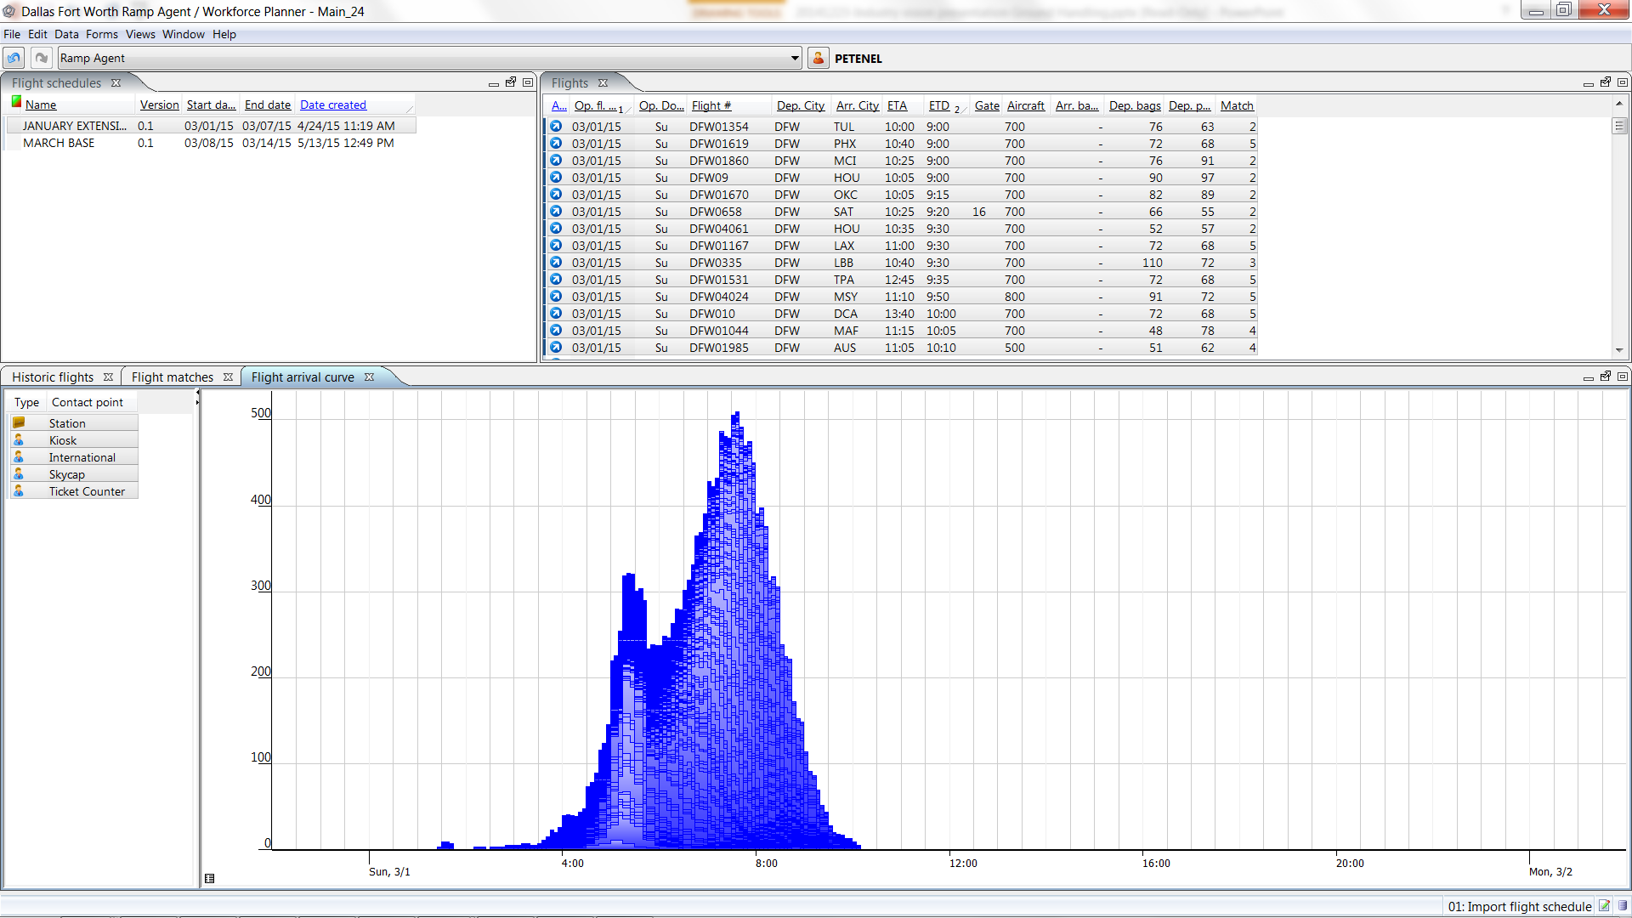
Planning
Long-term
Medium-term
Short-term
Predict Flight Reqmts
Import Flight Schedules
Task Creation/ Management
Task Requirements at Stations
Optimize demands, create shifts
Annual Leave Planning
Generate bid lines
Assign bid lines
Day of Ops, task assignment
Import Flight Schedules
Live data
Use predicted pax, and bags
Flight attributes such as tow-required
Key Benefits
Easy import of flight schedules
Visibility of loads
Solid basis for determining task requirements

Slide 16
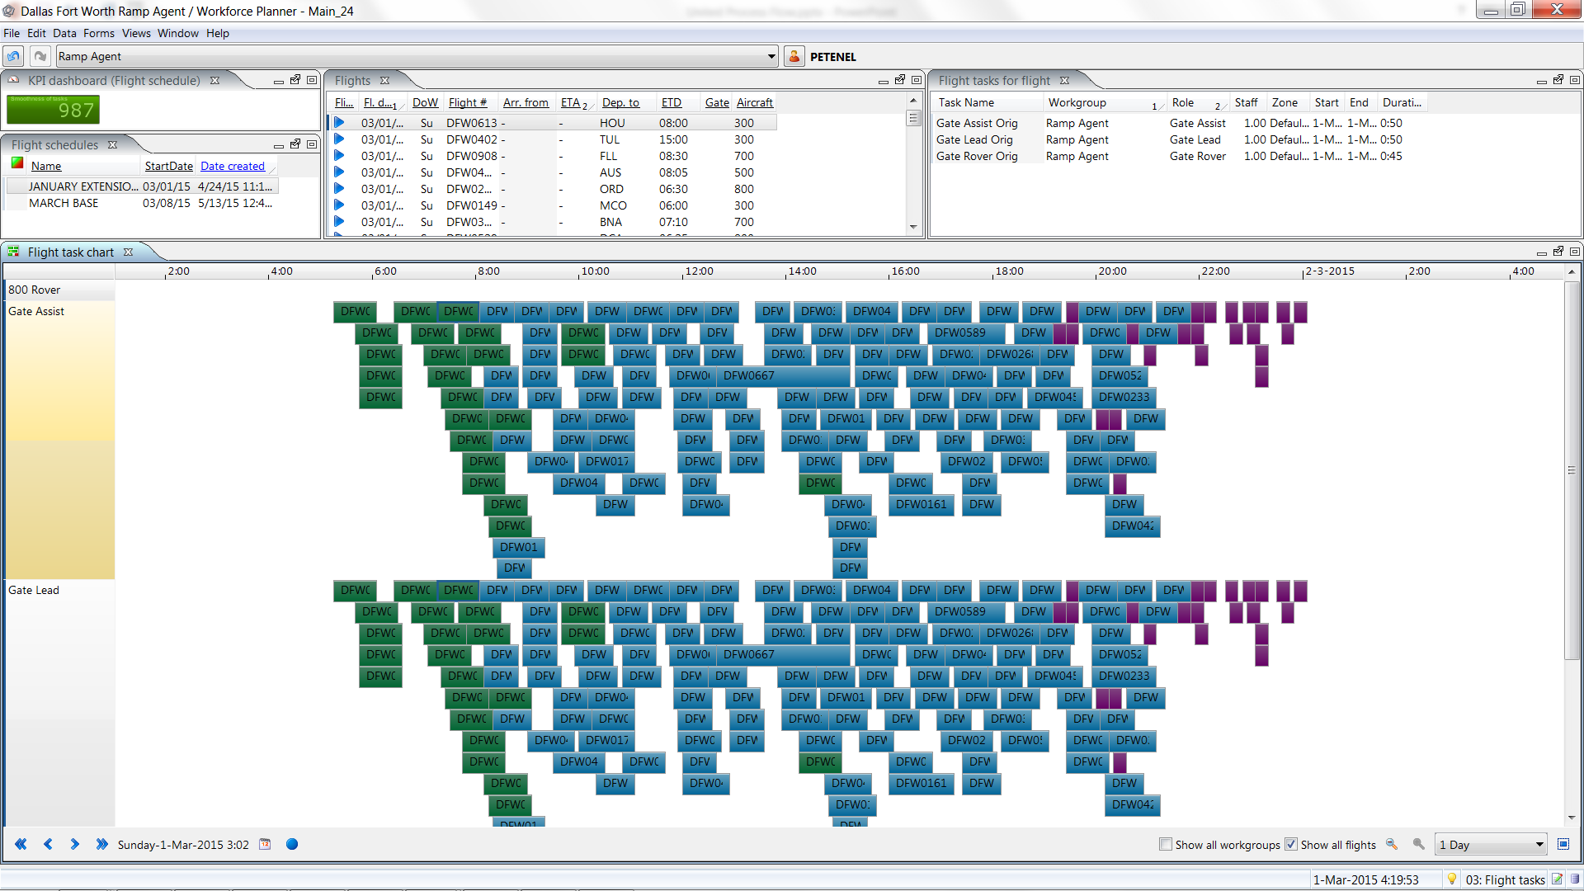

Planning
Long-term
Medium-term
Short-term
Predict Flight Reqmts
Import Flight Schedules
Task Creation/ Management
Task Requirements at Stations
Optimize demands, create shifts
Annual Leave Planning
Generate bid lines
Assign bid lines
Day of Ops, task assignment
Global Task Creation
Centralized and Scalable
Granular details of all individual required tasks
Rules-based
Key Benefits
Task smoothing slots tasks with flexible deadlines perfectly
Discover hidden opportunities for increased utilization
Enable continuous improvement

Slide 17
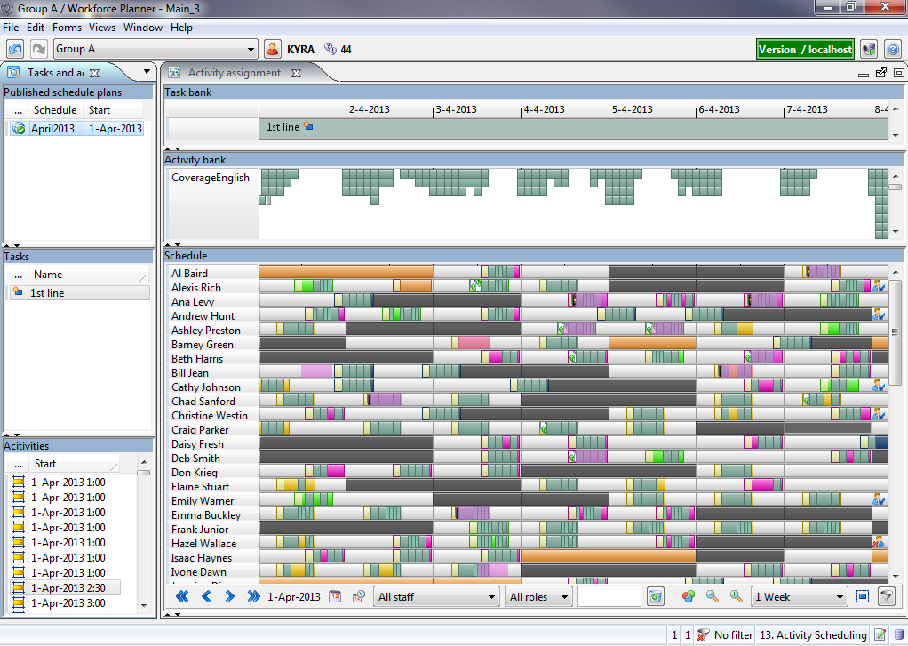

Planning
Long-term
Medium-term
Short-term
Predict Flight Reqmts
Import Flight Schedules
Task Creation/ Management
Task Requirements at Stations
Optimize demands, create shifts
Annual Leave Planning
Generate bid lines
Assign bid lines
Day of Ops, task assignment
Tasks Required at Stations
Driven by flight schedules
Local constraints and rules
Securely authorized
Key Benefits
Improve costs & productivity
Improve service delivery
Improve safety

Slide 18
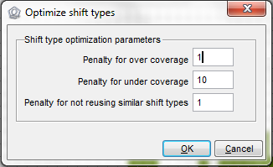
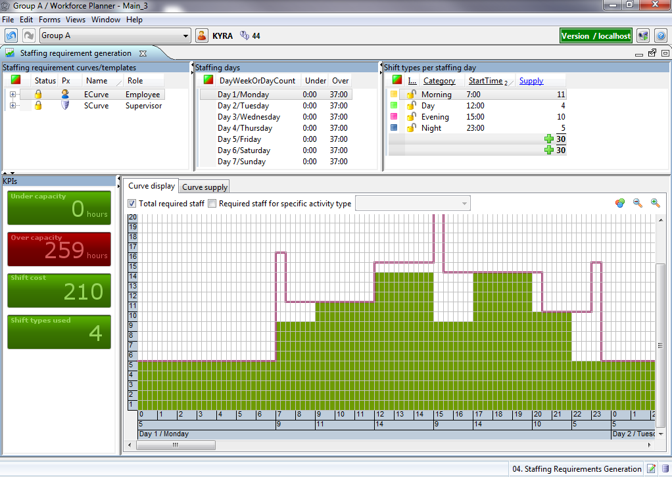

Planning
Long-term
Medium-term
Short-term
Predict Flight Reqmts
Import Flight Schedules
Task Creation/ Management
Task Requirements at Stations
Optimize demands, create shifts
Annual Leave Planning
Generate bid lines
Assign bid lines
Day of Ops, task assignment
Create optimal shifts
Aligned with task requirements
Automatically generated
Reviewable by users
Key Benefits
Improve decision making with what-if scenarios
Improve service delivery
Improve costs & productivity

Slide 19
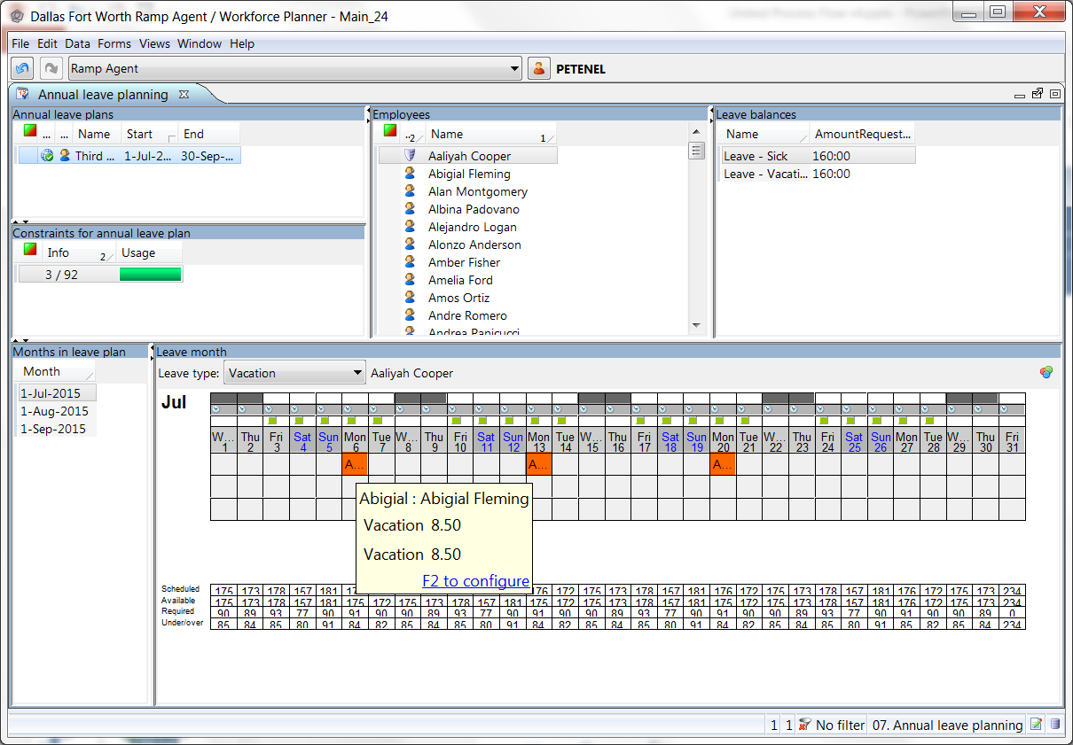

Planning
Long-term
Medium-term
Short-term
Predict Flight Reqmts
Import Flight Schedules
Task Creation/ Management
Task Requirements at Stations
Optimize demands, create shifts
Annual Leave Planning
Generate bid lines
Assign bid lines
Day of Ops, task assignment
Annual Leave Planning
Keep operations smooth
Monitor balances for leave
Interactive for employees, mobile
Key Benefits
Keep operations running at high levels, even during peak leave periods
Increased responsiveness enhances employee satisfaction
Improved accuracy/reliability of the plan itself

Slide 20
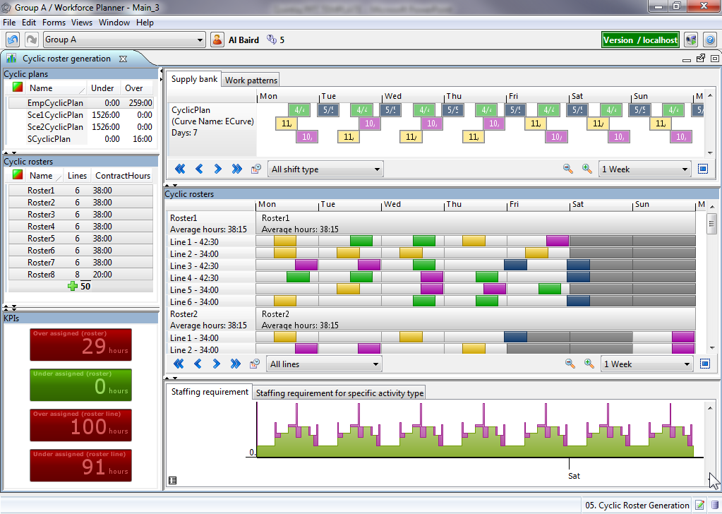
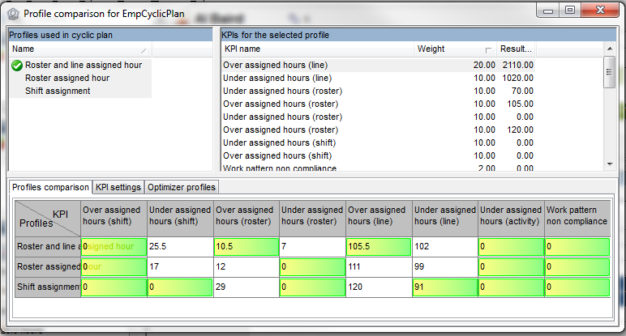

Planning
Long-term
Medium-term
Short-term
Predict Flight Reqmts
Import Flight Schedules
Task Creation/ Management
Task Requirements at Stations
Optimize demands, create shifts
Annual Leave Planning
Generate bid lines
Assign bid lines
Day of Ops, task assignment
Generate bid lines
Aligned with available shifts
Any time cycle
Respects contracts, preferences, and rules
Key Benefits
Reduce under capacity
Reduce over capacity
Ensure compliance with rules and preferences

Slide 21
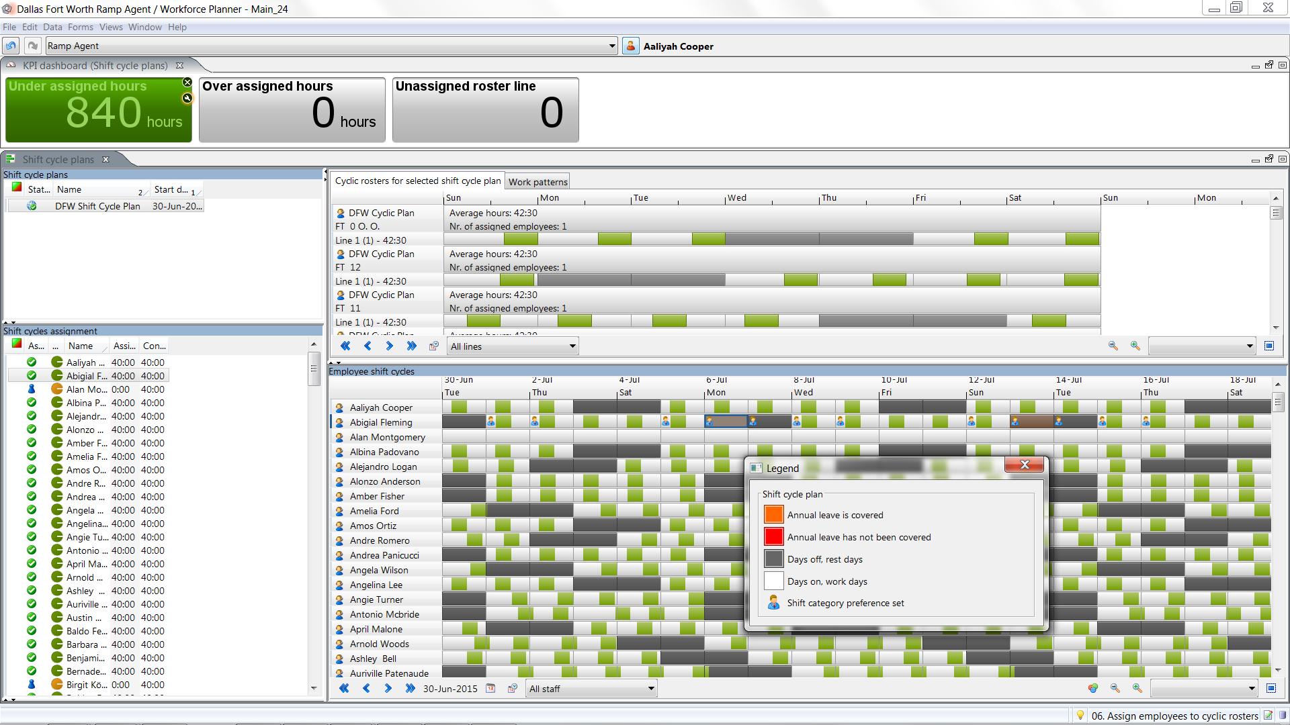
Planning
Long-term
Medium-term
Short-term
Predict Flight Reqmts
Import Flight Schedules
Task Creation/ Management
Task Requirements at Stations
Optimize demands, create shifts
Annual Leave Planning
Generate bid lines
Assign bid lines
Day of Ops, task assignment
Assign bid lines
Users may bid on shifts
Follows rules such as seniority and more
Key Benefits
Increased task coverage with fewer shifts
Engage employees
Ensure compliance with rules and preferences

Slide 22
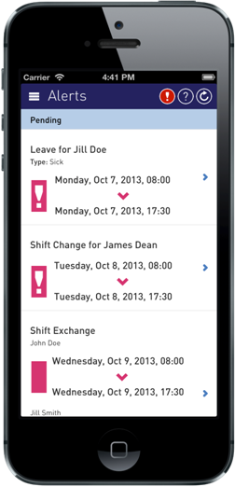
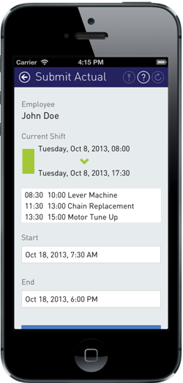
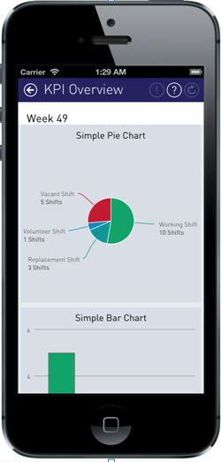
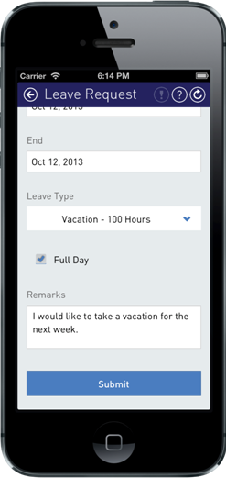
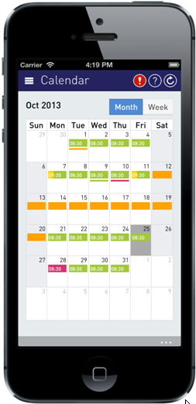

Planning
Long-term
Medium-term
Short-term
Predict Flight Reqmts
Import Flight Schedules
Task Creation/ Management
Task Requirements at Stations
Optimize demands, create shifts
Annual Leave Planning
Generate bid lines
Assign bid lines
Day of Ops, task assignment
Task assignment, Day of Ops
Employee task assignment
Real-time
Mobile convenience out-of-the-box
Key Benefits
Improve service reliability and responsiveness
Improve visibility & transparency
Improve employee satisfaction

Slide 23
Agenda
Introductions
Overview and Understanding of United Airlines Puzzle
Quintiq Overview
Demonstration
Demonstration
Quintiq Architecture
Quintiq Customers
Quintiq EngaQugement Process
Quintiq Engagement Process
Quintiq EngaQugement Process
Q&A, Next Steps

Slide 24

Quintiq three layer architecture
Customer
Layer
United Airlines core business rules
Industry
Solutions
Workforce Planner: Cyclic rostering and scheduling
Demand & Macro Planner: Forecast and replenishment
Logistics Planner: Delivery planning and scheduling
Quintiq Standard
Software
Quintiq Standard Software
Used by all Quintiq Customers
Capacities shared by all planning applications:
Business model and logic execution
Visualization and interaction
Optimization
Integration
h

Slide 25





















Overview: Quintiq software components
Presentation
Quintiq
thin clients
Quintiq
mobile clients
Reports
Network
Quintiq
gateway
Web server
Visualization
Quintiq
thin client
engines
Quintiq
mobility engines
Quintiq
remote job engine
Scalability
Quintiq
dispatcher
engines
Business
Quintiq application engine
Quintiq
knowledge engine
Integration
Data
GIS
LDAP
SAP
ODBC
Message queue
SOAP
Excel
Email / iCal
Flat file
Notes:
Owner: Technology, Paul-Erik Raue
Talk through the Quintiq engines. Main points: Quintiq applications have a multi-tiered architecture (client, server, data) and not all of these components are required. Which exact components are required for the customer depends on what functionality they want to achieve and how large their scale is.
Presentation/Visualization tier
Java Thin Client + Thin Client Engine: displays GUI communicating only what is visible on screen in real-time
Mobile Clients + Web Server + Mobility Engine: displays information on mobile or desktop using native applications or HTML5
Remote Job Engine: complex reporting
Scalability tier
Dispatcher Engine: allows offloading of processing from the Quintiq Application Engine to the Quintiq Dispatcher Engine. Important to note is that the QDEs can be layered themselves (a QDE can connect to another QDE). This layer also offers filtering functionality so that data does not get to the QTCEs/QMEs/QRJEs which can be important for security (for example if customers connect from outside to a QME and you want to make sure that the data on the QME does not contain any internal information
Business tier
Quintiq Application Engine: calculates and propagates business rules and ensures data consistency.
Quintiq Knowledge Engine: holds shared knowledge for multiple instances of Quintiq.
Integration tier
Integration components for connecting Quintiq to other systems such as PTV/GeoConcept (for mapping functionality), ActiveDirectory (for user authentication), SQL Server/Oracle (for data storage), MSMQ/OracleMQ (message queueing), etc.
Data tier
External data sources and persistent storage for the data

Slide 26
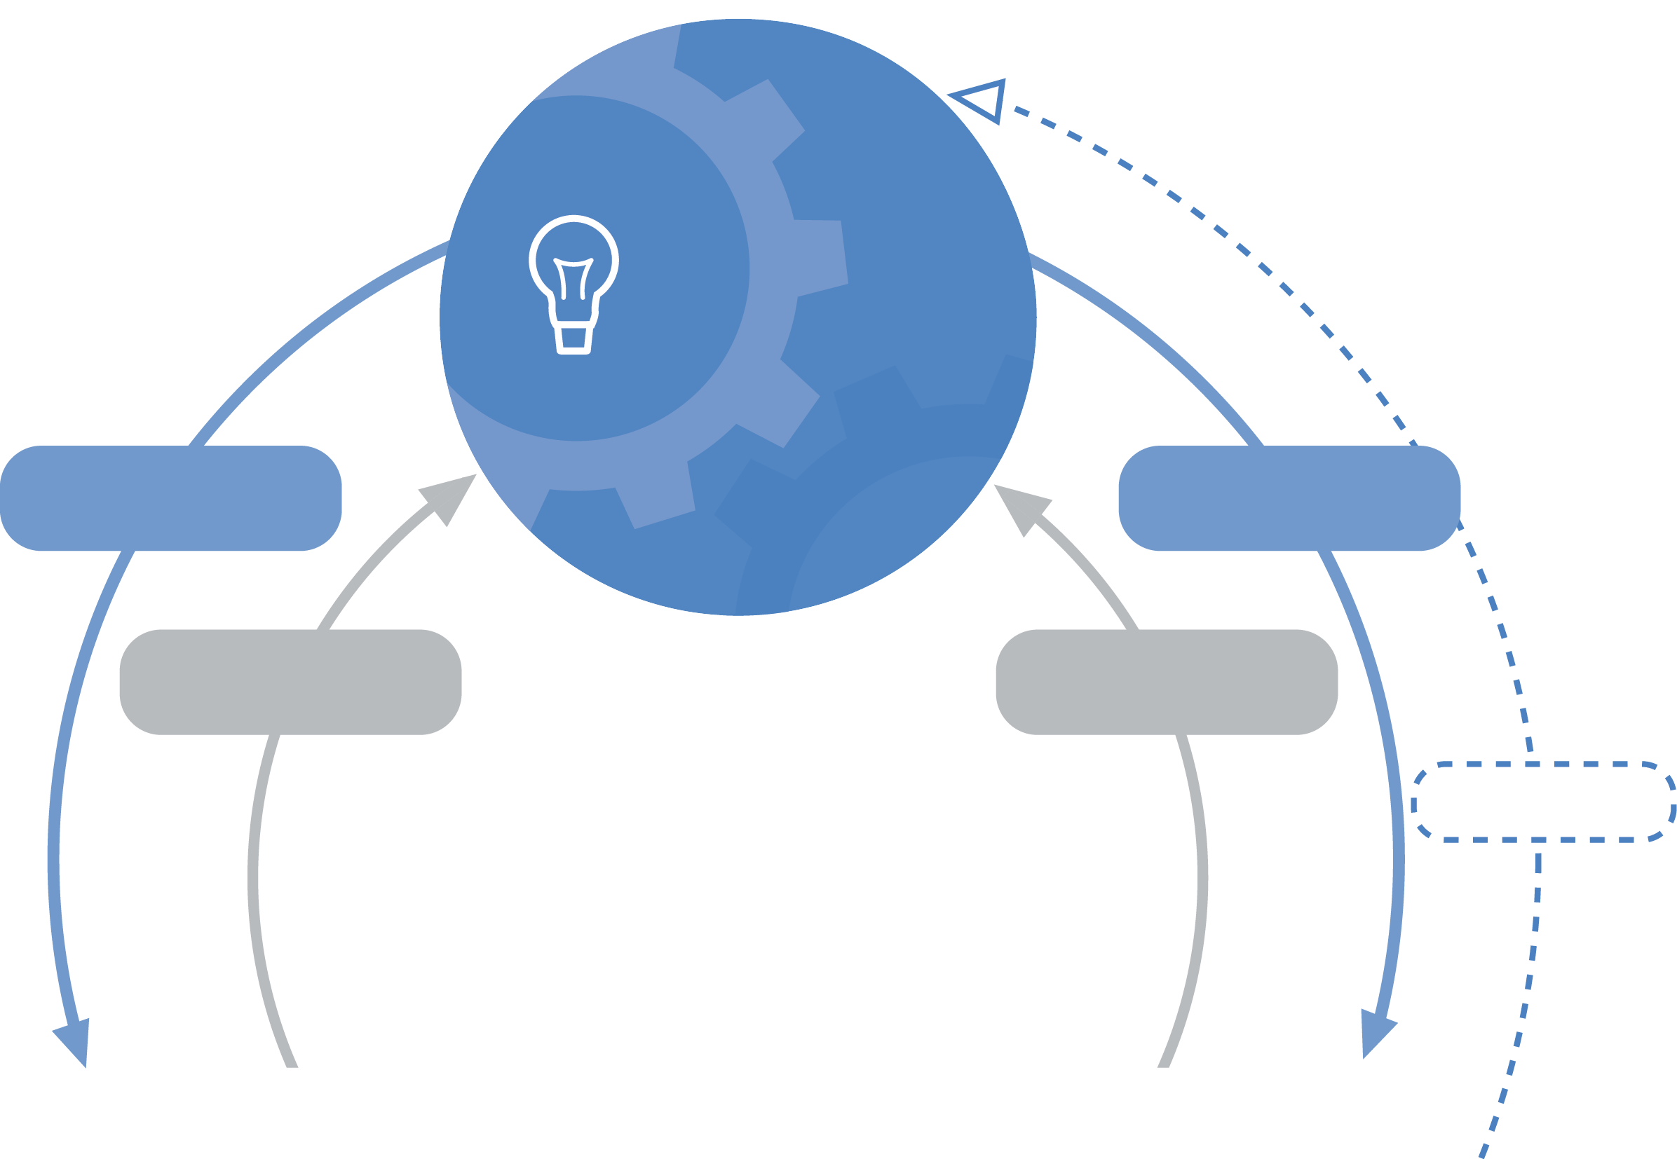
Record-breaking optimization technology comes standard
Real results
Vlisco
lead time
reduced by
50%
Sapa
WIP
reduced by
20%
LSG Skychefs
vans reduced by
35%
SIG Combibloc
internal
lot sizes
increased by
10%
Optimization Center offers dedicated expertise to customer projects
Quintiq
R&D
Optimization
technology
Optimization
Center
Optimization
technology
Quintiq proprietary
logic language (Quill)
Mathematical programming
Constraint programming
Path optimization
Graph algorithms
and more…
Experience&
knowledge
Experience&
knowledge
feedback
Benchmarks
Performance
Logistics, Workforce, Production
5-20% improvement
for nearly every customer
122 world records

Slide 27
Agenda
Introductions
Overview and Understanding of United Airlines Puzzle
Quintiq Overview
Demonstration
Demonstration
Quintiq Architecture
Quintiq Customers
Quintiq EngaQugement Process
Quintiq Engagement Process
Quintiq EngaQugement Process
Q&A, Next Steps

Slide 28
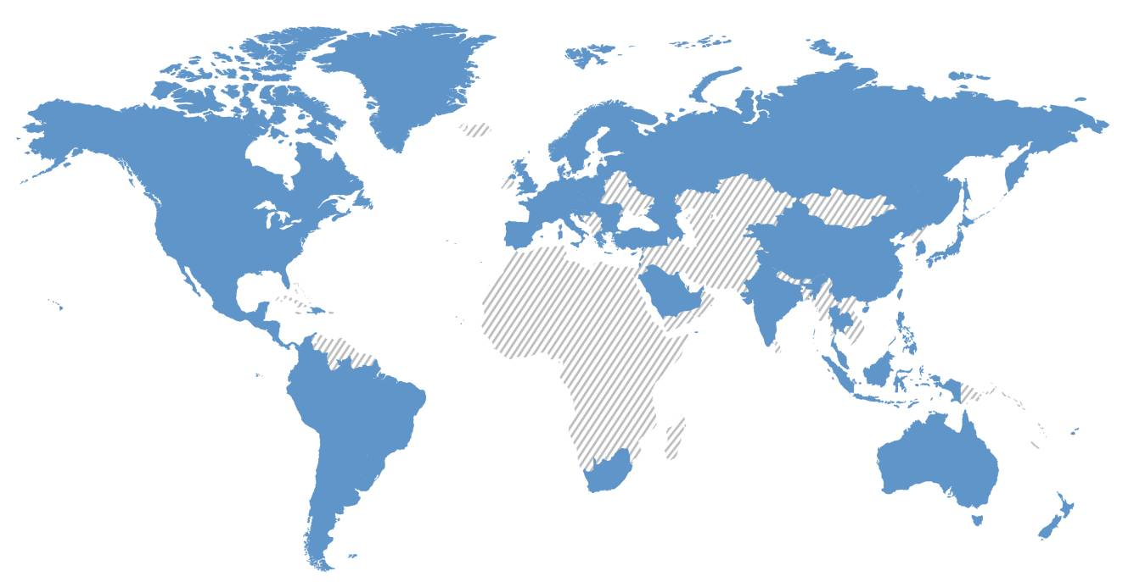



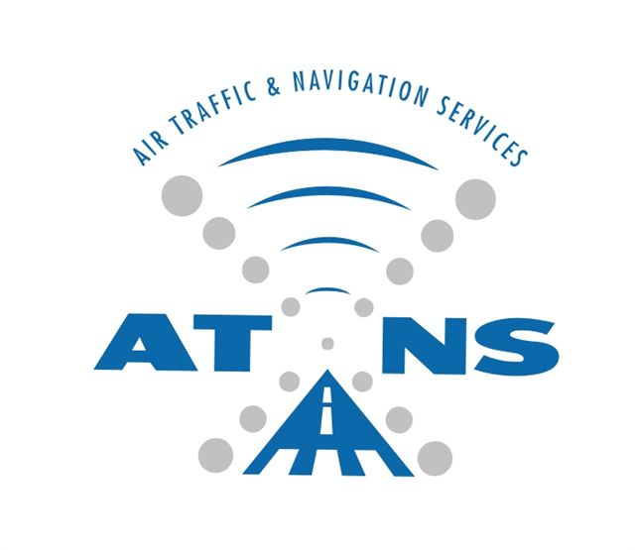



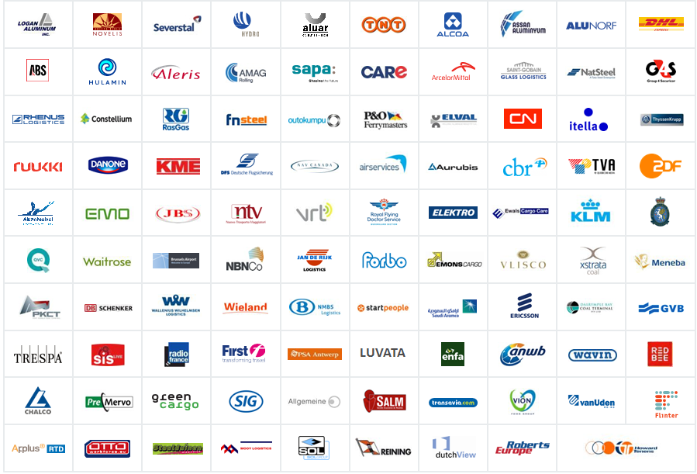





Where Quintiq is used
FAA - USA
Quintiq is currently used in over 80 countries worldwide
Quintiq is used by leading aviation companies
Selected Quintiq customers
Notes:
Customer references:
Put them in the slide deck when prospects asks about them. Above show the current Ground handling / aviation customers.
Reference slides can be found on the solutions portal

Slide 29
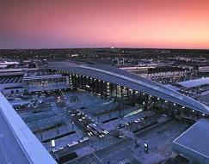

Copenhagen Airport
Challenge | Sought a resource management system that would provide a common technology platform across 11 departments Support the needs of 11 departments
Solution | Standardizes personnel planning transparently in a real-time planning environment Enables ease of planning days off; staff can swap shifts and indicate working preferences
Why Quintiq? | Quintiq solution was chosen to support a shared planning process for CPH that will allow for automation and optimization across the departments Can be configured to meet the specific rules associated with Denmark’s labor regulations as well as union agreements for each department
Benefits | One software platform to plan all 11 CPH departments, incorporating all planning locations Increased efficiency Enhanced customer satisfaction Improved employee satisfaction – better management of preferences. Labor and union law compliance
Fast facts
Industry: Airports Annual revenue: €469 million Number of employees: 2,200 Operational staff planned by Quintiq: 1,700 Location: Copenhagen, Denmark Solution: Workforce Planner Customer since: 2013
“Using multiple systems to roster staff in 11 departments and plan their assignments was a very complex process. We chose Quintiq’s application as it offers greater visibility and flexibility for handling real-time events, particularly with its mobile application.”
Kristian Durhuus,
COO, Copenhagen Airports

Slide 30
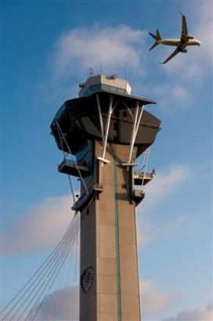
FAA – United States of America
Background
The FAA is responsible for the safety of civil aviation. The FAA's mission is to provide the safest, most efficient aerospace system in the world. The FAA's 48,000 employees operate the air traffic and navigation system in the U.S.A., regulate civil aviation and airport safety, regulate commercial space transportation and advance aviation safety globally.
Solution
The solution needed to exactly meet the specific scheduling needs of the FAA:
Incorporate short-term scheduling, long-term planning, and annual leave planning.
Meet government regulations regarding the number of controllers and the licensing necessary to man each sector.
Comply with a complicated set of labor agreements.
Integrate with FAA’s IT environment.
Run complex staffing scenarios to determine optimal staffing levels per location. Manage all types of labor contracts within the FAA Air Traffic Organization.
“The FAA agreement marks an important milestone in our company growth. Our current customer base covers more than 30% of the global airspace. The ANSP vertical is yet another market where Quintiq has achieved leadership; we are committed to extending our market leading position further in the coming years.”
Benefits
Optimizing staffing levels while continuing to ensure safe and efficient operations.
The number of ATCOs can be adjusted exactly to the flow of traffic.
Controllers are positioned in the right sectors based on qualifications to ensure that safety regulations are strictly adhered to.
The system can include different labor agreements for each control center and take employee preferences into consideration.
Victor Allis, CEO Quintiq

Slide 31
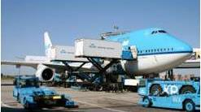
KLM Catering Services (KCS) – The Netherlands
Background
KLM Catering Services Schiphol (KCS) prepares and delivers 45,000 meals a day for 12 airlines, 350 flights, and 50 different types of aircraft. KCS needed to optimize the speed of its service delivery, maintain consistent delivery performance and product quality, increase productivity levels, and control costs. KCS selected Quintiq for the flexibility of its software and the short implementation time needed.
Solution
“This is one of the few IT projects which has been implemented on time and within budget. The punctuality of the distribution of the catering products to the aircraft has increased from 98% to 99.5%, which is an important improvement for us. It has exceeded our expectations concerning the functional requirements”.
The goods that the company transports vary greatly from day to day in number, content, shape and packaging.
There are extremely strict food hygiene rules (HACCP norms), and product quality regulations to follow.
Due to the nature of airport operations, there are always last-minute orders, gate changes, flight schedule revisions, and unexpected onboard materials that must be handled.
Benefits
Delivery performance improved from 98% to 99.5%.
A 3% gain in capacity through the more efficient use of its vehicles and drivers.
The system has proven so valuable and reliable that additional activities, such as de-icing aircraft, have also been included.
Jacques Blaauw, Managing Director, KLM Catering Services

Slide 32
Agenda
Introductions
Overview and Understanding of United Airlines Puzzle
Quintiq Overview
Demonstration
Demonstration
Quintiq Architecture
Quintiq Customers
Quintiq EngaQugement Process
Quintiq Engagement Process
Quintiq EngaQugement Process
Q&A, Next Steps

Slide 33



Typical engagement process
The following is the typical Engagement, and Objective of the SCAN and Demo Challenge:
Scan/vision presentation
What is the business puzzle you are trying to solve?
Demo challenge
Validate the business opportunity
Prove the capability of Quintiq in supporting business needs
Sales engagement
Who is Quintiq?
What do we do?
2-Day Process:
Objective:
To understand your business objectives and the puzzle you are trying to solve.
5-Day Process (Scope Dependent):
Objectives:
Prove Quintiq’s capability in supporting the business needs
Identify tangible business benefits
Provide you with the Quintiq Experience

Slide 34
Agenda
Introductions
Overview and Understanding of United Airlines Puzzle
Quintiq Overview
Demonstration
Demonstration
Quintiq Architecture
Quintiq Customers
Quintiq EngaQugement Process
Quintiq Engagement Process
Quintiq EngaQugement Process
Q&A, Next Steps

Slide 35
Thank you!
Donna Davis
Account Executive
Pete Nelson
Solutions Architect
Dr. Edwin Lohmann
Business Unit Director
Notes:
Owner: TC Baker, BUNA, February 2013

